Slide 1
LLMs Use Cases
Noah, William and Manami

Slide 2
Finance - JPMorgan Chase
References:
Financial AI Overview
AI in Banking Case Study
Diagram of Architecture
Chase Application

Slide 3
Use Case
JPMorgan uses LLMs to analyze market trends, assess financial risks, and predict investment opportunities. The LLM models process financial data, including news articles, reports, and market patterns, to provide financial insights for portfolio management.

Slide 4
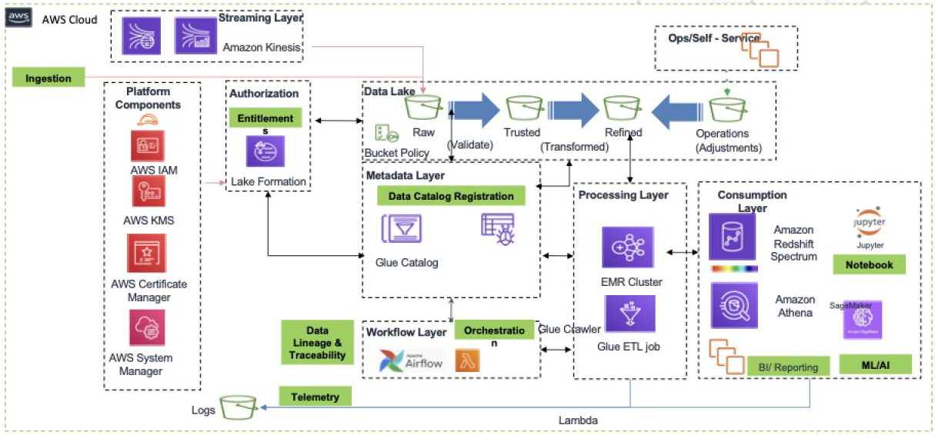
Diagram of Application’s Business Logic
Notes:
On the left we can see that they use AWS IAM for identity and access management, KMS for key management, Certificate Manager to manage SSL certificates and System Manager to manage & operate AWS resources. Across the top we can see the lake layers: Raw, Trusted (after validation) and Refined (after transformation and adjustments). The data lake is built and managed by AWS Lake Formation, including access management (authorisation and entitlement). They use Glue Crawler to collect metadata from the lake (including data lineage) and Glue Data Catalog to store it. Apache Airflow is used to orchestrate the workflow. Lambda (serverless) is used for logging the ETL/ETL and reporting activities/usage. Glue and EMR are used for data processing, while Redshift Spectrum to query lake data on S3 buckets. For ML/AI and BI they use Jupyter notebooks, Athena and SageMaker, and for streaming they use Kinesis.

Slide 5
Key Prompts
"Analyze current market conditions and provide a risk assessment for [stock/industry]."
"Predict investment opportunities in emerging markets for the next quarter."
"Evaluate the impact of [global event] on the stock prices of [industry/region]."
"Identify emerging risks in [country/market] that could affect portfolio performance."
"Compare the financial health of [two companies] and suggest which one is a safer investment."

Slide 6

Screenshot of Application

Slide 7
Automotive - Wavye
References
Top Automotive AI Companies
Wayve AI

Slide 8
Use Case
The main use case of Wayve AI is to enable autonomous driving through Embodied AI. Their approach focuses on creating an AI "robot brain" that equips vehicles to learn from and interact with real-world driving environments, delivering safe, scalable, and adaptable driving automation.
Notes:
### Speaker Notes
Wayve Technologies is pioneering the development of AI foundation models for autonomous driving, focusing on *Embodied AI* to enhance the safety and adaptability of driving automation. Their **AV2.0 approach** replaces the traditional sense-plan-act model of autonomous vehicles (AV1.0) with an end-to-end neural network that learns directly from raw data using self-supervised learning. This enables AV2.0 to operate without relying on HD maps and adapt across different vehicles and environments.
Key innovations include:
- **Fleet Learning Loop**: A continuous cycle of data collection, model training, and deployment to enhance real-world driving capabilities.
- **LINGO**: A vision-language model that improves the interpretability and training of AI, offering insights into decision-making.
- **GAIA**: A generative world model that simulates driving scenarios, improving training and validation through realistic video generation.
Their technology promises scalable, safer autonomous driving, supported by collaborations with major players like Microsoft to build advanced supercomputing infrastructure.

Slide 9
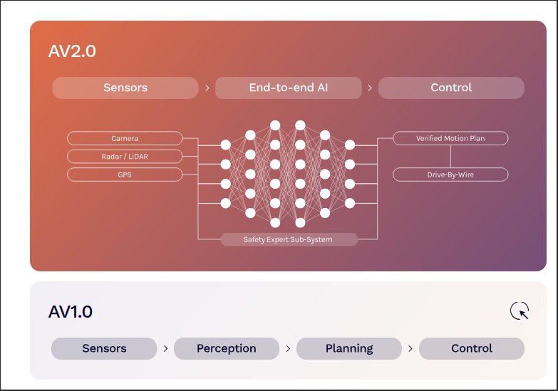
Diagram of Application’s Business Logic
Notes:
Certainly! Here’s an overview of the diagram you described, detailing how it represents Wayve's AV2.0 approach and the underlying business logic:
### Diagram Overview
1. **Sensors**:
- The diagram starts with various types of sensors: **cameras**, **radar/LiDAR**, and **GPT**.
- These sensors collect raw data from the environment, providing essential information about surroundings, obstacles, and driving conditions.
2. **End-to-End AI**:
- The collected data flows into an **end-to-end AI model**. This model processes the raw inputs through a unified neural network, enabling real-time interpretation and decision-making without the need for a traditional sense-plan-act approach.
- Within this model, there is a **safety export subsystem** that is dedicated to ensuring safe operation by continuously assessing the environment and the vehicle's actions.
3. **Control**:
- The output of the end-to-end AI leads to a **control system**. This system includes a **verified motion plan**, which formulates a safe and efficient route based on the AI’s assessments.
- The control system is connected to **drive-by-wire technology**, allowing electronic control of the vehicle's steering, acceleration, and braking, ensuring precise and responsive vehicle handling.
### Business Logic Explanation
- **Data-Driven Approach**:
- The entire process emphasizes a **data-first philosophy**, where learning occurs directly from raw sensor data rather than relying on pre-labeled datasets. This enhances the adaptability and efficiency of the AI, enabling it to learn from real-world scenarios effectively.
- **Safety and Robustness**:
- The integration of a safety export subsystem within the AI model prioritizes **automotive safety**. This feature enables the system to make informed decisions to avoid potential hazards, thereby enhancing trust in autonomous driving technologies.
- **Adaptability and Scalability**:
- The architecture allows Wayve's technology to adapt to various vehicles (e.g., passenger cars, delivery vans) and geographical areas without extensive reconfiguration. This **vehicle-agnostic** capability means advancements in one domain benefit all others, facilitating broader market adoption.
- **Fleet Learning Loop**:
- The continuous loop of data gathering, model training, evaluation, and deployment enhances performance over time. This **fleet learning loop** harnesses insights from multiple vehicles in diverse conditions, driving improvements and learning capabilities across the fleet.
- **Advanced AI Capabilities**:
- Innovations like **LINGO-1** and **GAIA-1** improve the AI's interpretability and predictive capabilities. These models enable better understanding of decision-making processes and generate realistic simulations for training, thereby enhancing the model's robustness.
### Conclusion
The diagram illustrates how Wayve’s AV2.0 approach integrates advanced sensor technologies and a holistic AI model to create a safe and adaptable autonomous driving system. By streamlining the learning process and emphasizing safety and flexibility, Wayve positions itself as a leader in the development of autonomous driving solutions. Sure! Here’s a concise summary of the diagram and its business logic:
### Diagram Summary
1. **Sensors**:
- The system starts with various sensors (cameras, radar/LiDAR, GPT) that collect raw environmental data.
2. **End-to-End AI**:
- This data is processed by an end-to-end AI model, which includes a safety export subsystem to ensure safe decision-making.
3. **Control**:
- The AI output leads to a control system that generates a verified motion plan and connects to drive-by-wire technology for precise vehicle control.
### Business Logic Summary
- **Data-Driven Learning**:
- The system learns from raw sensor data without needing labeled datasets, enhancing adaptability.
- **Safety and Robustness**:
- A focus on safety ensures informed decisions to avoid hazards during autonomous operation.
- **Adaptability**:
- The architecture supports various vehicles and environments, benefiting from shared advancements.
- **Continuous Learning**:
- A fleet learning loop continuously improves performance by gathering insights from real-world data.
Overall, Wayve’s AV2.0 approach integrates sensor technologies with advanced AI to create a safe and flexible autonomous driving solution.

Slide 10
Key Prompts
GAIA Simulation Prompt: "Generate realistic driving scenarios for a delivery vehicle navigating a busy urban environment, including potential obstacles and traffic patterns."
LINGO Decision Explanation Prompt: "Explain the rationale behind the vehicle's decision to reroute due to unexpected road closures, using natural language to improve transparency."
Fleet Learning Feedback Prompt: "Analyze data from the fleet's recent driving experiences to identify common challenges and recommend improvements for route optimization."
AV2.0 Adaptability Prompt: "Evaluate the adaptability of the AV2.0 model in various weather conditions and provide insights on performance improvements needed for enhanced safety."
Mapless Autonomy Assessment Prompt: "Assess the effectiveness of mapless navigation in unfamiliar areas and propose strategies for improving the vehicle's decision-making in real-time."

Slide 11
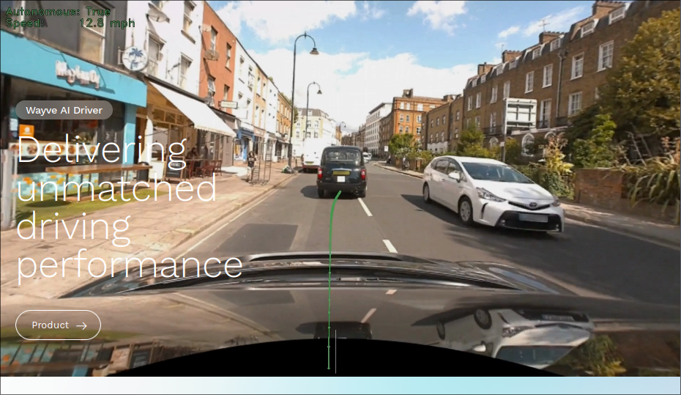
Screenshot of Application

Slide 12
Education - IONI
References
https://springsapps.com/knowledge/how-llm-can-transform-education
https://ioni.ai/
Services
AI Assistant
AI Chatbot
AI Search
AI conversation Analytics

Slide 13
Use Case
AI Agents for schools and universities (multiple purposes: students’ support, onboarding, teachers’ personal helper, etc.)
Integrated AI assistant for your LMS or other learning software (this is its core meaning of llm in education - using LLMs as educational software integrators)
Custom AI Agent for businesses that have staff education programs or different educational institutions that provide eLearning options
Advanced customisation of the features included in the product up to your requirements.
Custom UI design and branding of the application.
Key Highlights:
Provides 24/7 tutoring support
Adaptive learning experiences based on student performance
Available across multiple devices, ensuring accessibility

Slide 14
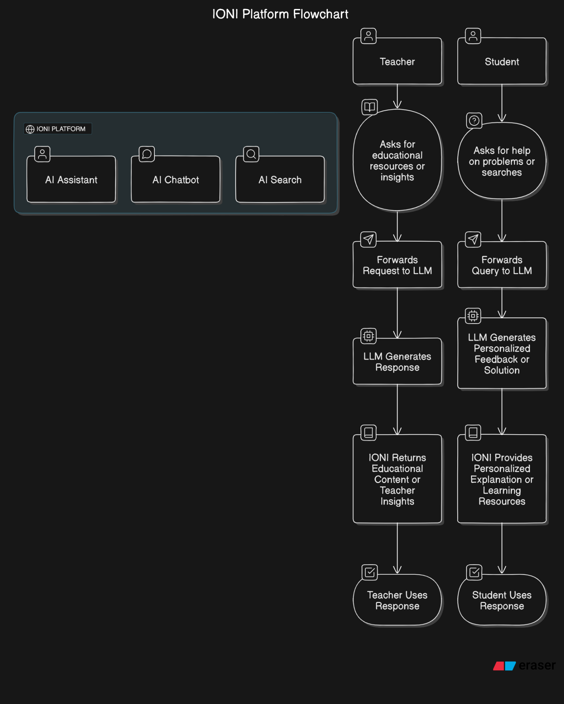
Diagram of Application Business Logic

Slide 15
Key Prompts
Possible Key Prompts:
“Explain the concept of photosynthesis in simple terms for a 10-year-old.”
“How do you solve this quadratic equation: x²+ 5x + 6 = 0 ?
“I need help understanding Newton's third law of motion.”
“What is the capital of France, and can you provide a short history of it?”
“Summarize Chapter 5 of ‘To Kill a Mockingbird.’”

Slide 16
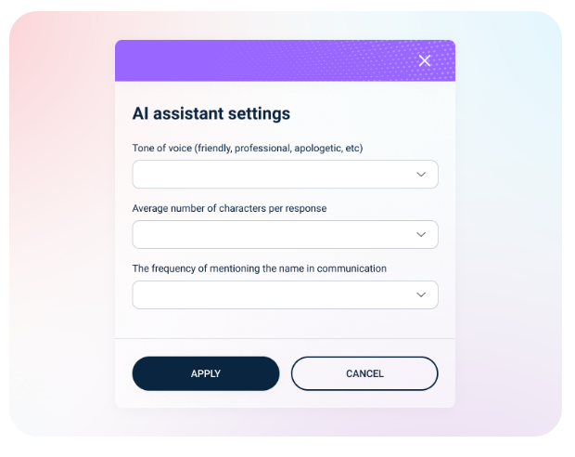
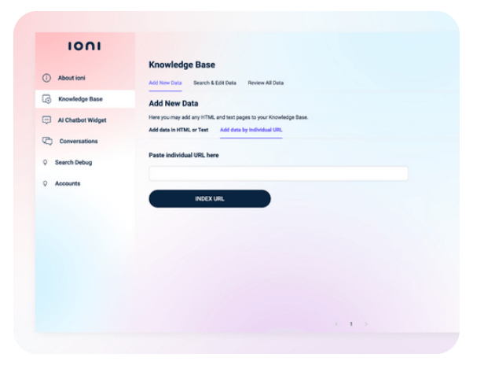
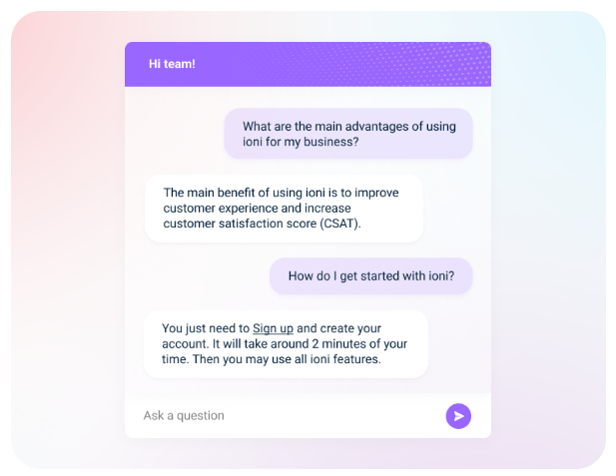
Screenshot of Application

